Slide 1


Slide 2
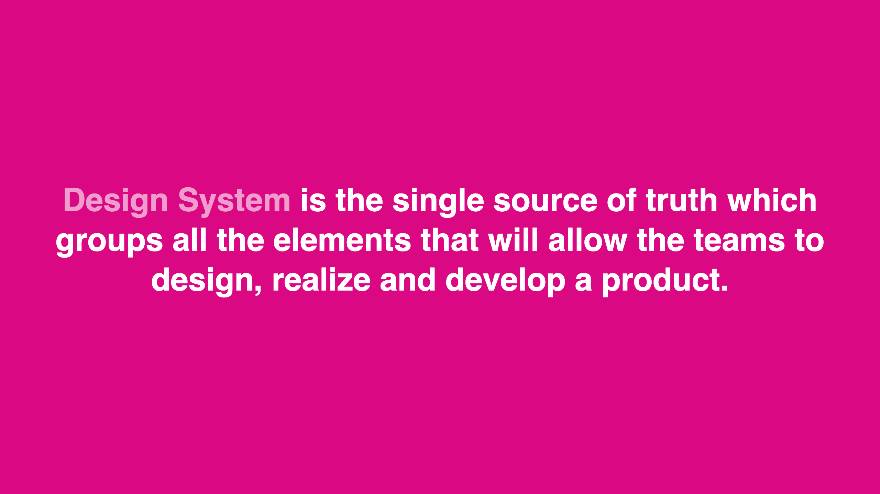
Notes:
@Audrey Hacq in her article “Everything you need to know about Design Systems”, source: https://uxdesign.cc/everything-you-need-to-know-about-design-systems-54b109851969

Slide 3
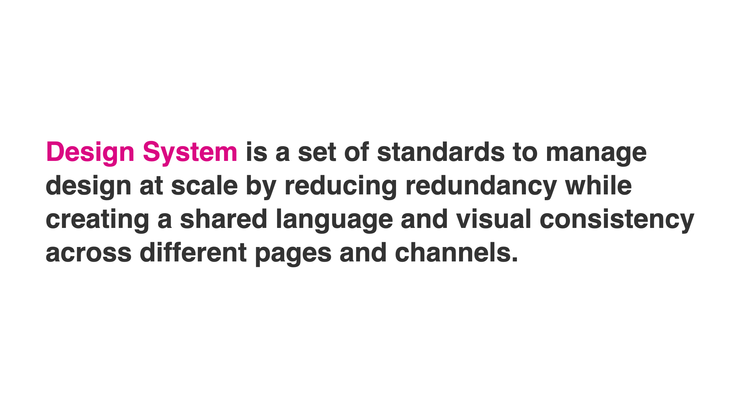

Slide 4
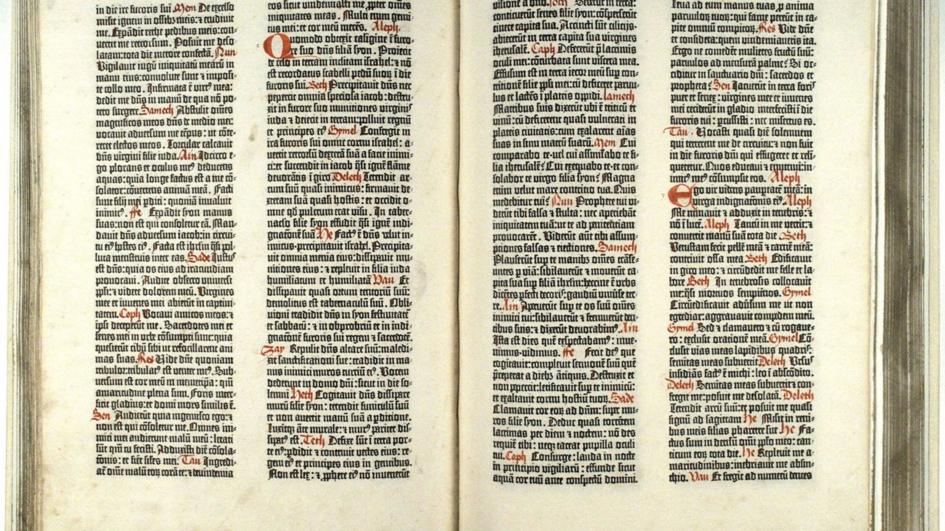
Notes:
Source: https://assets.runemadsen.com/classes/programming-design-systems/a-history-of-design-systems/index.html

Slide 5
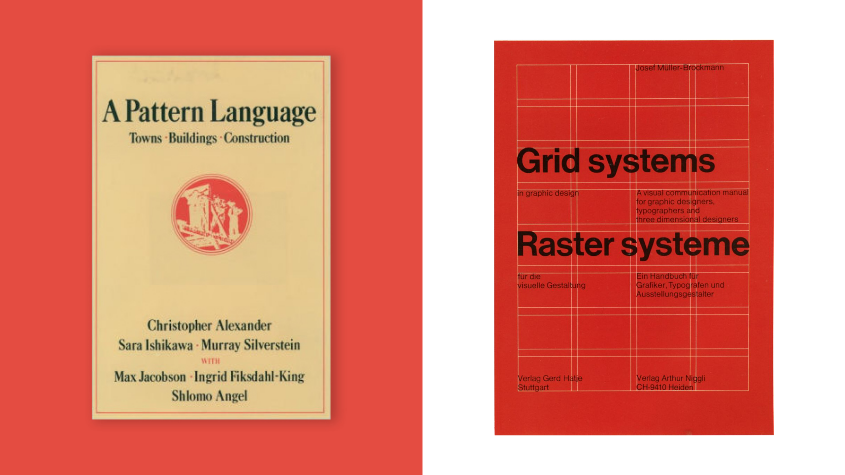
Notes:
Show: https://www.pinterest.com/pin/christopher-alexander-pattern-language--388928117790365326/

Slide 6
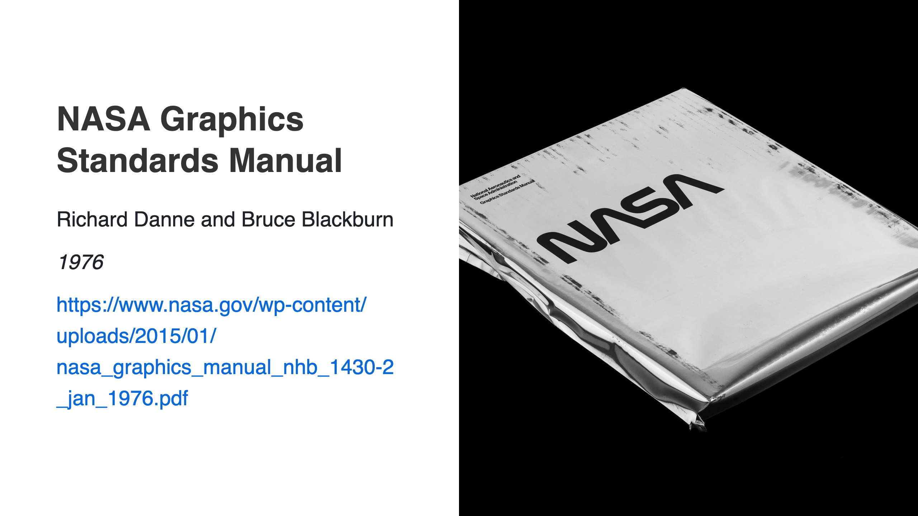

Slide 7
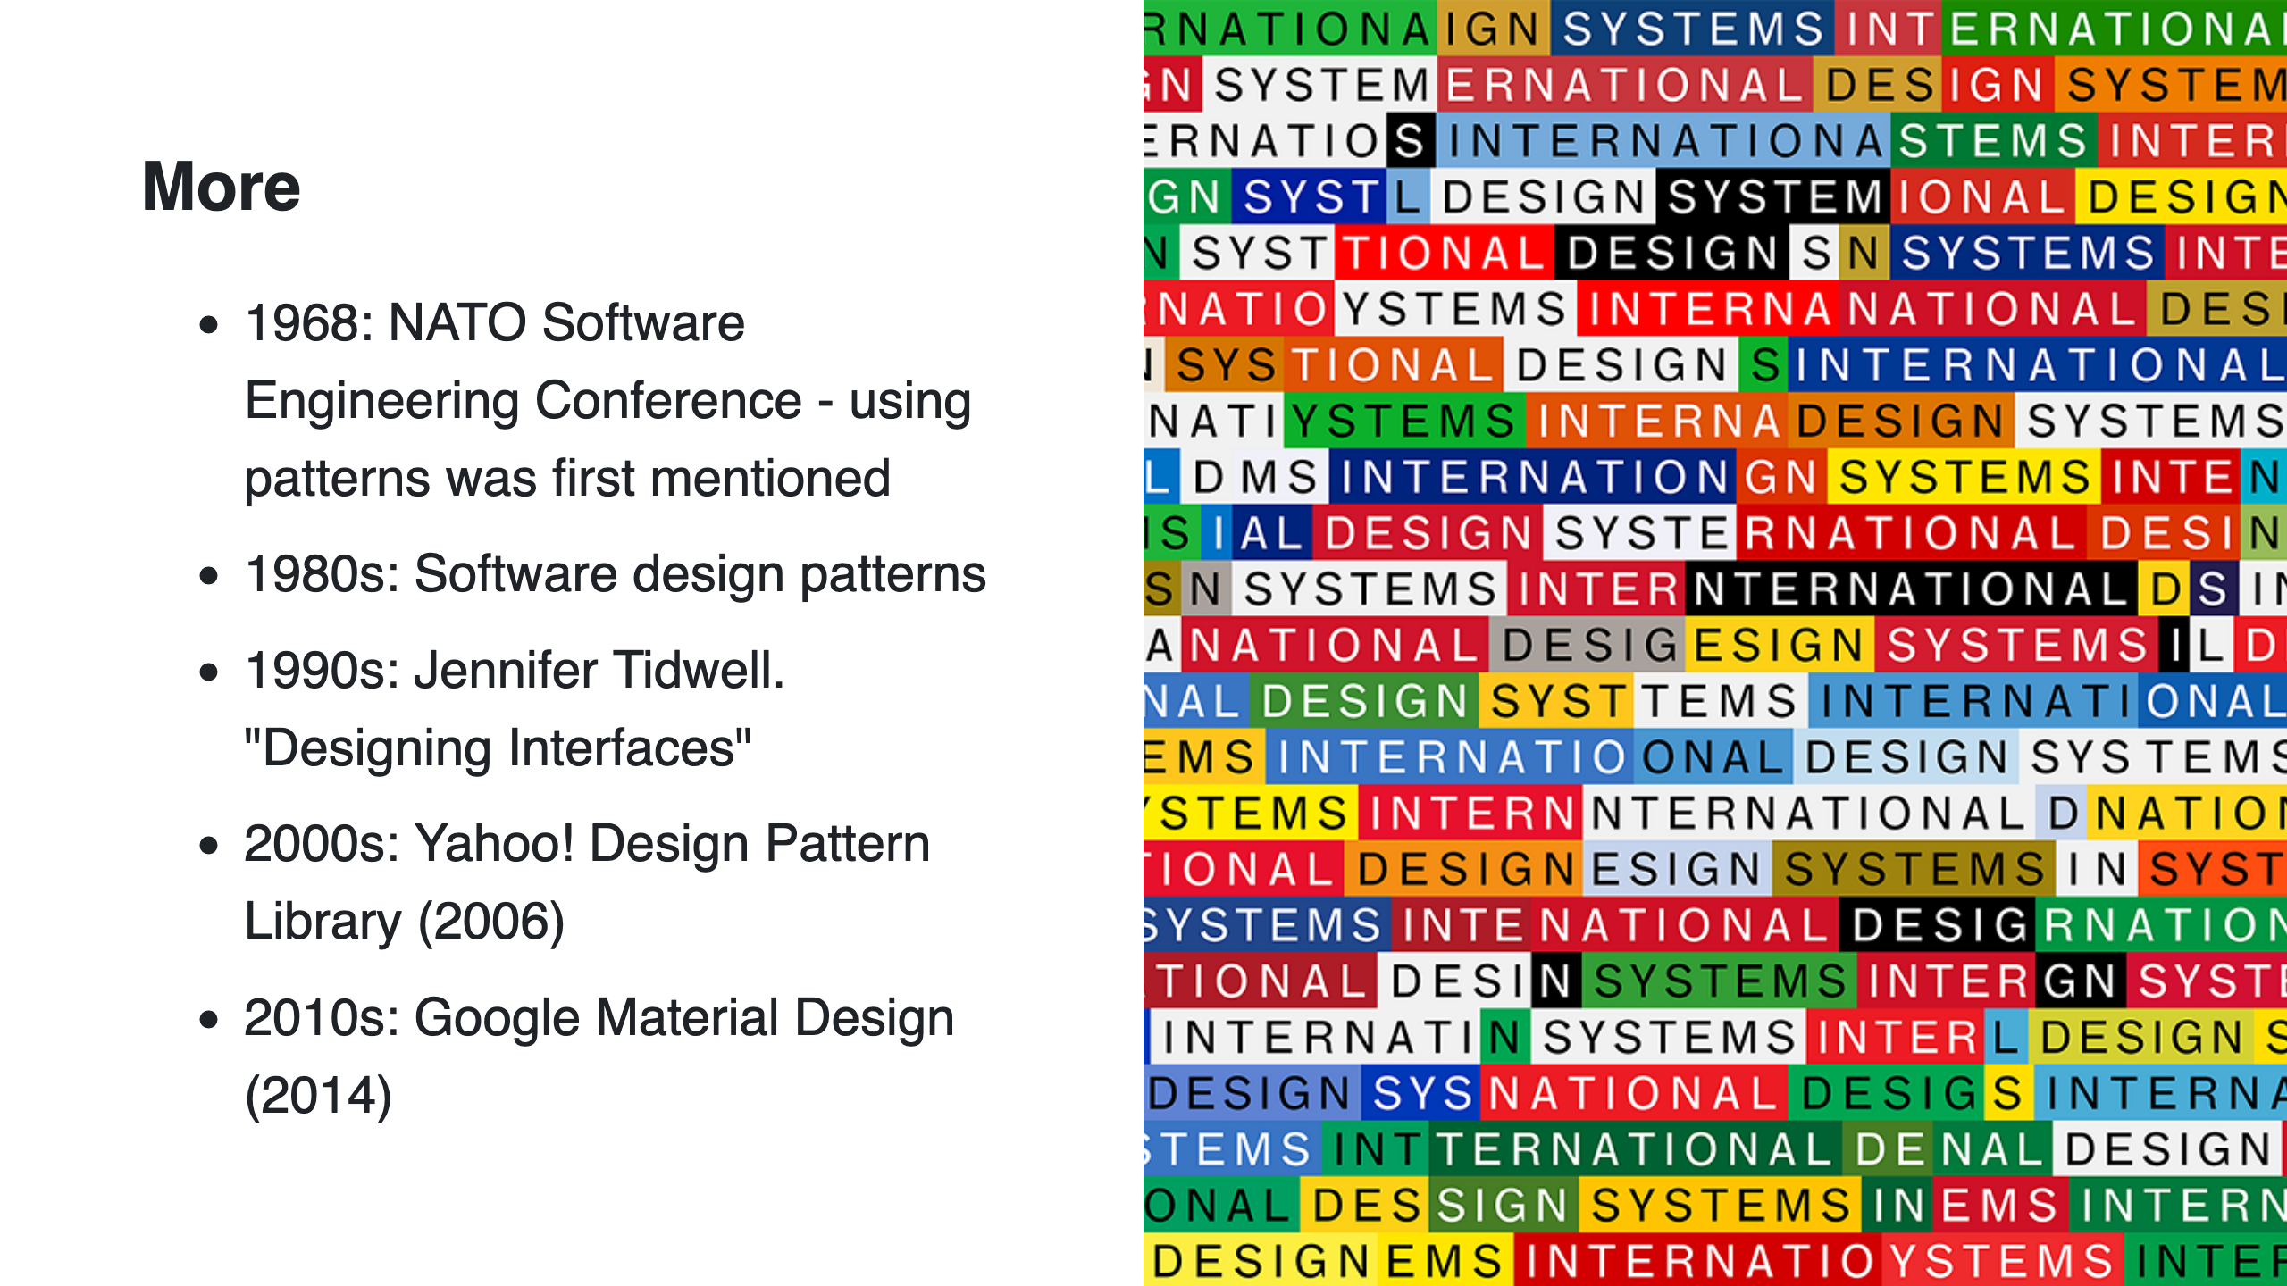

Slide 8
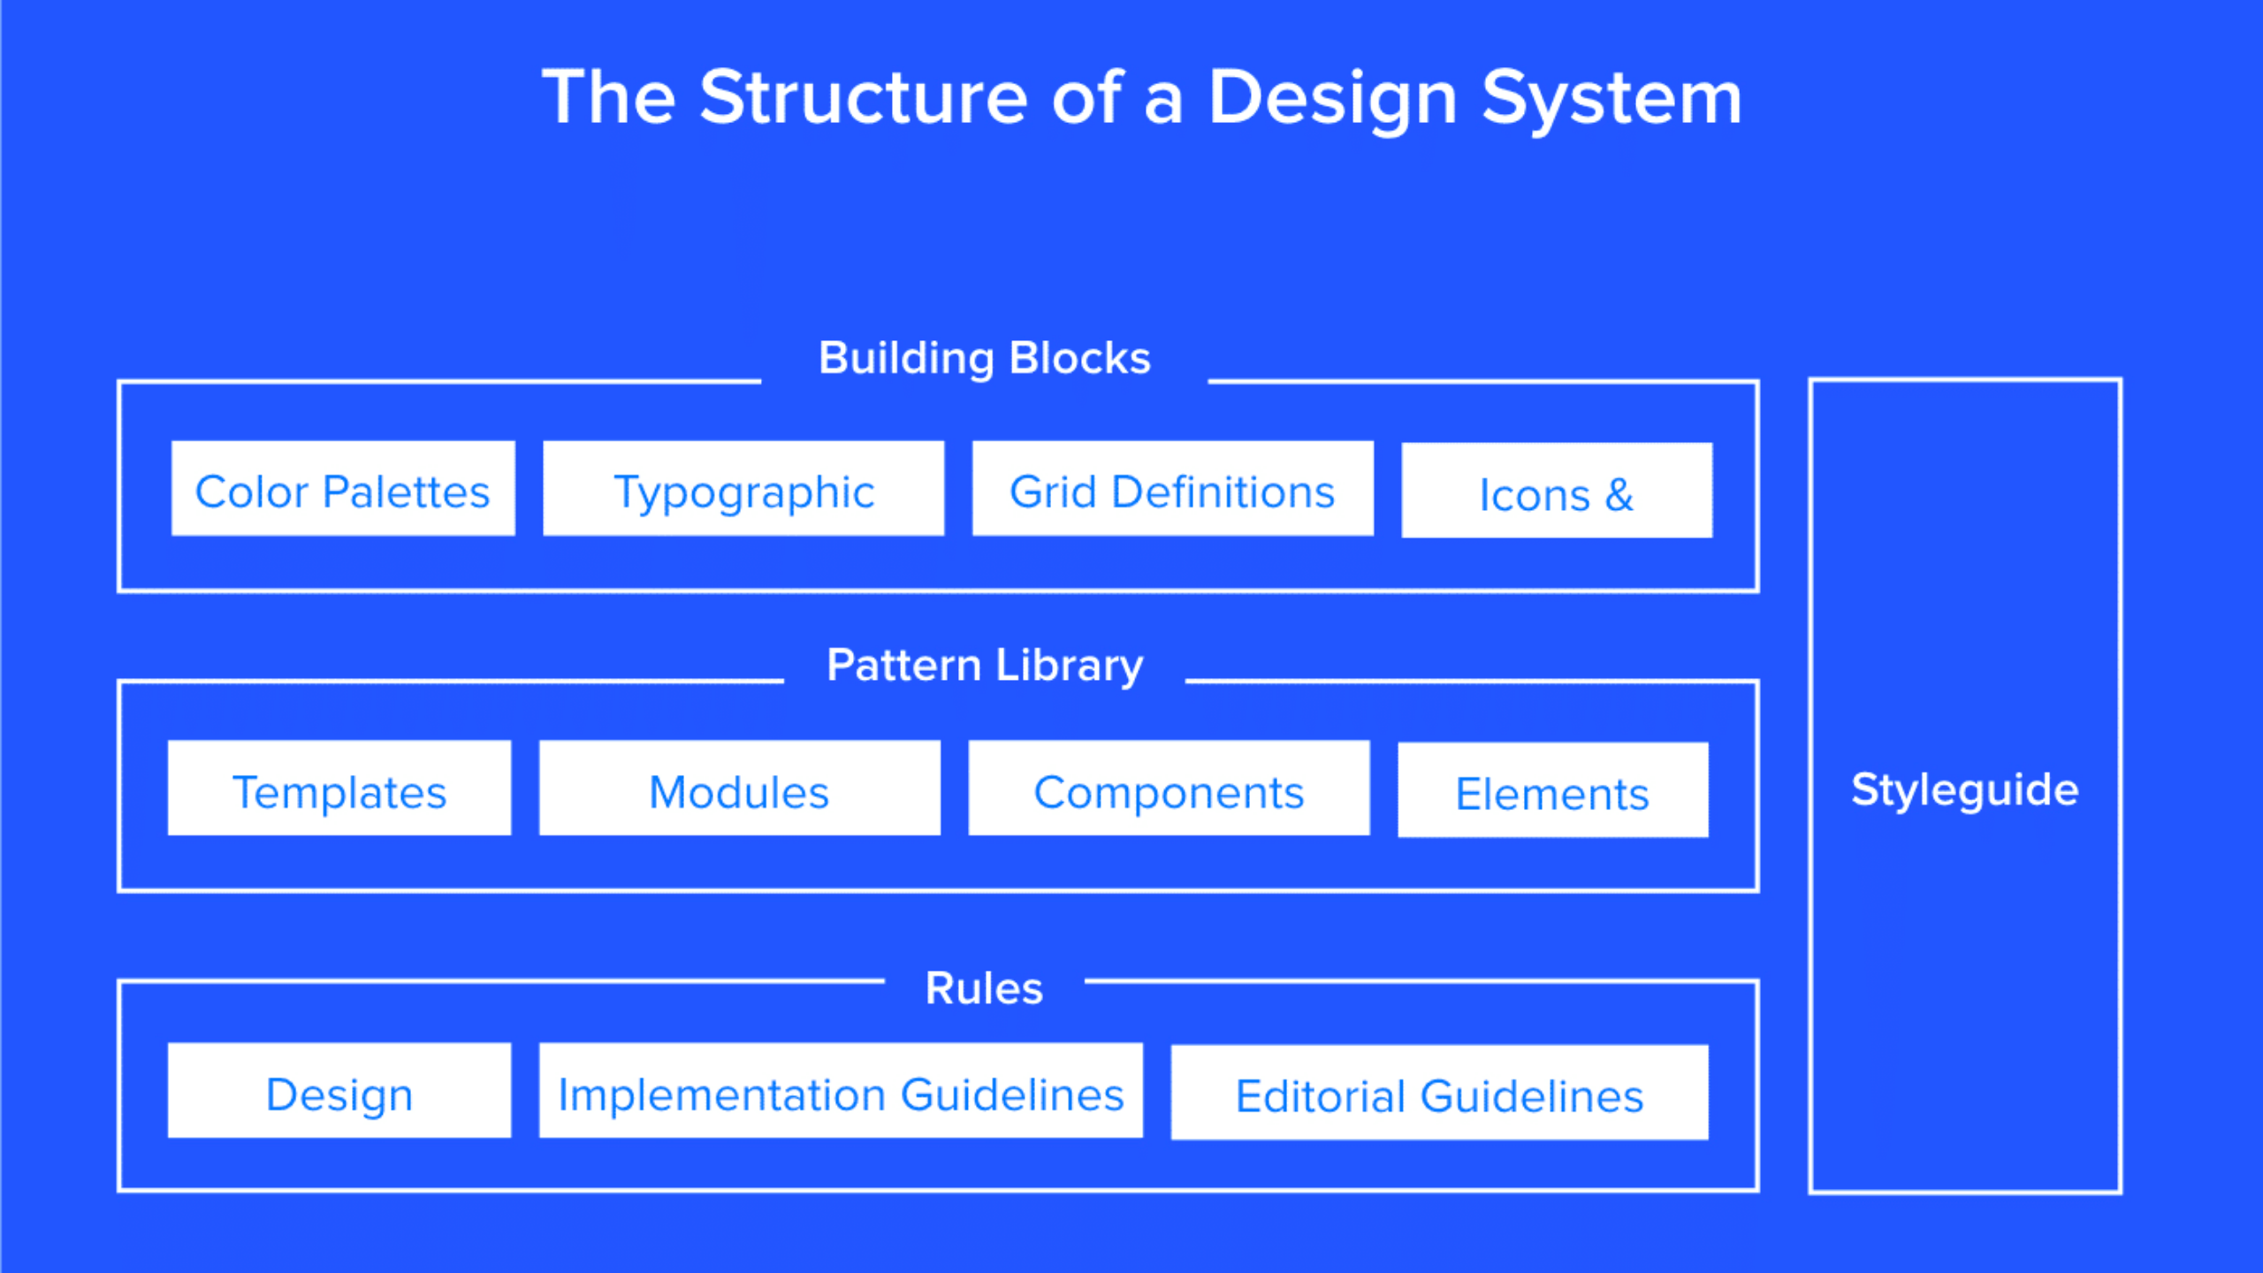

Slide 9
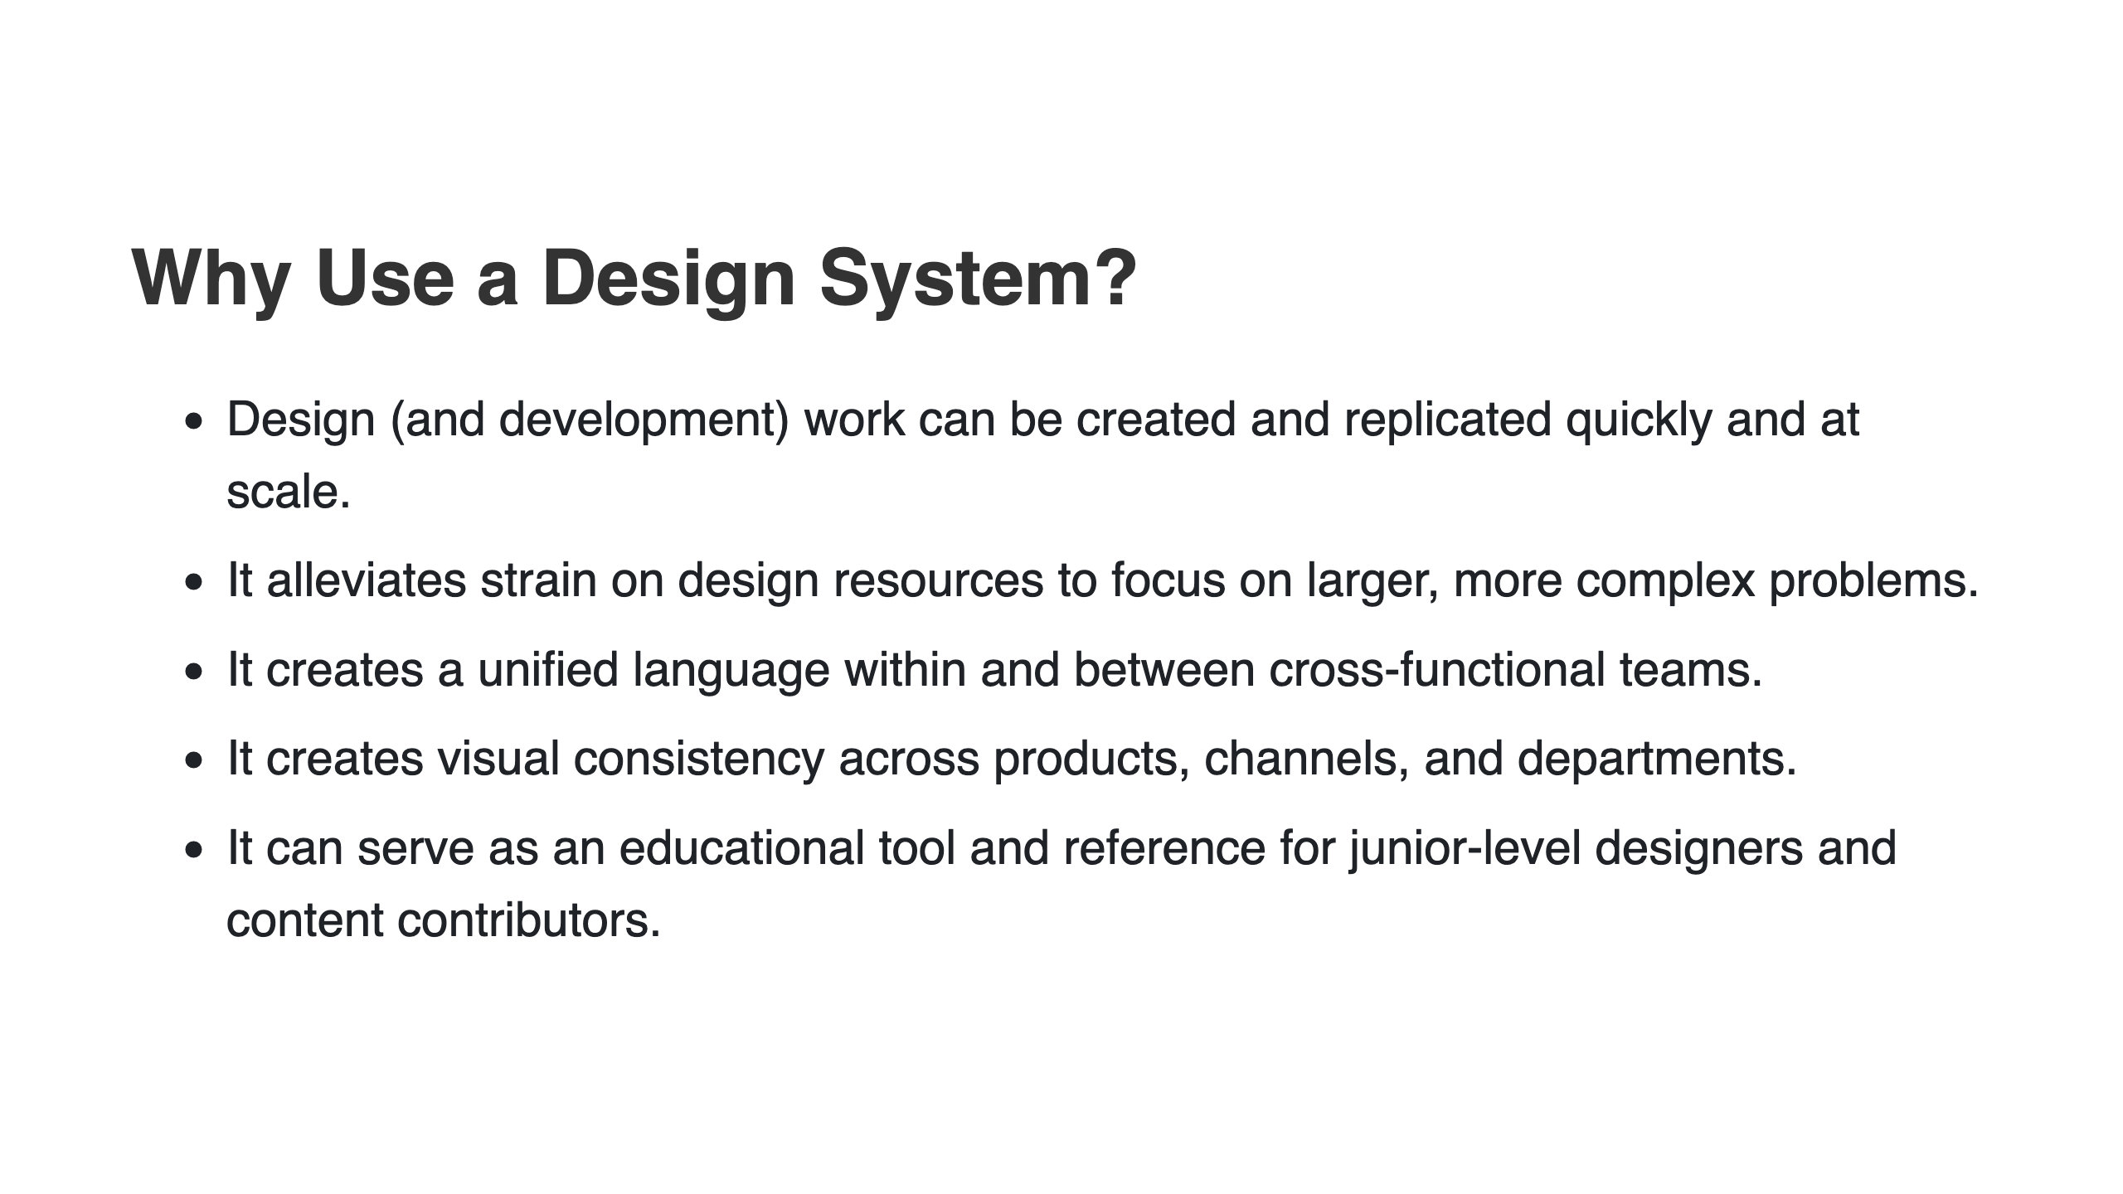
Notes:
@source:https://www.nngroup.com/articles/design-systems-101/

Slide 10
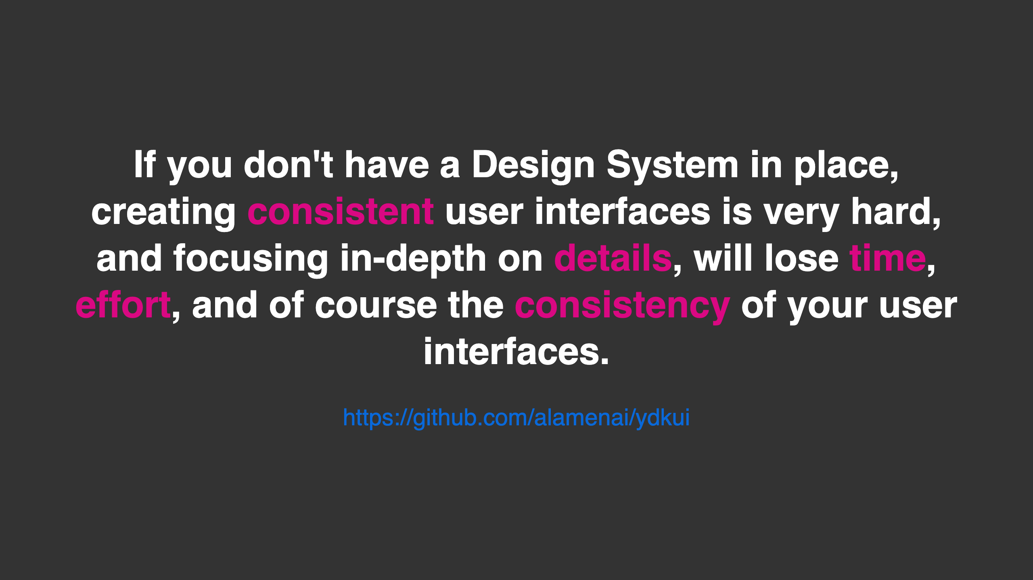

Slide 11
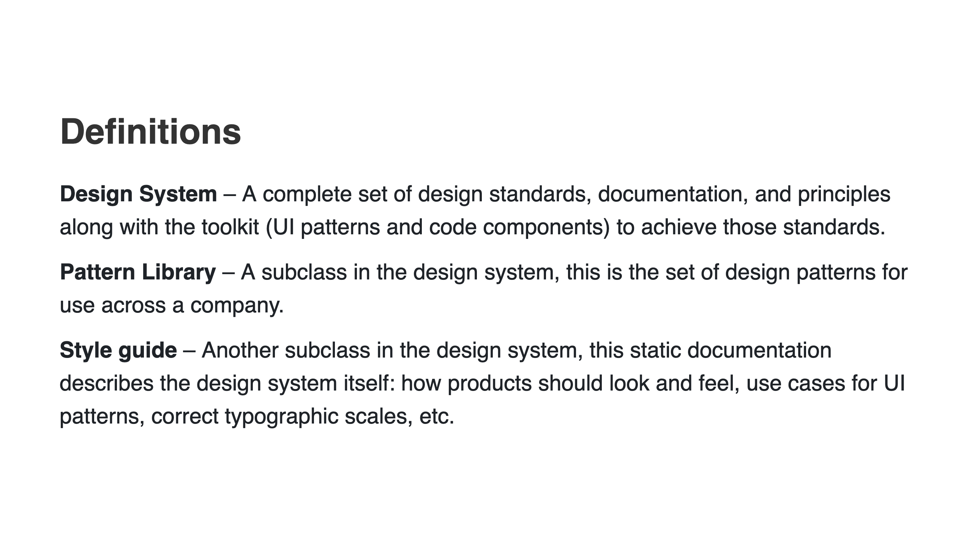

Slide 12
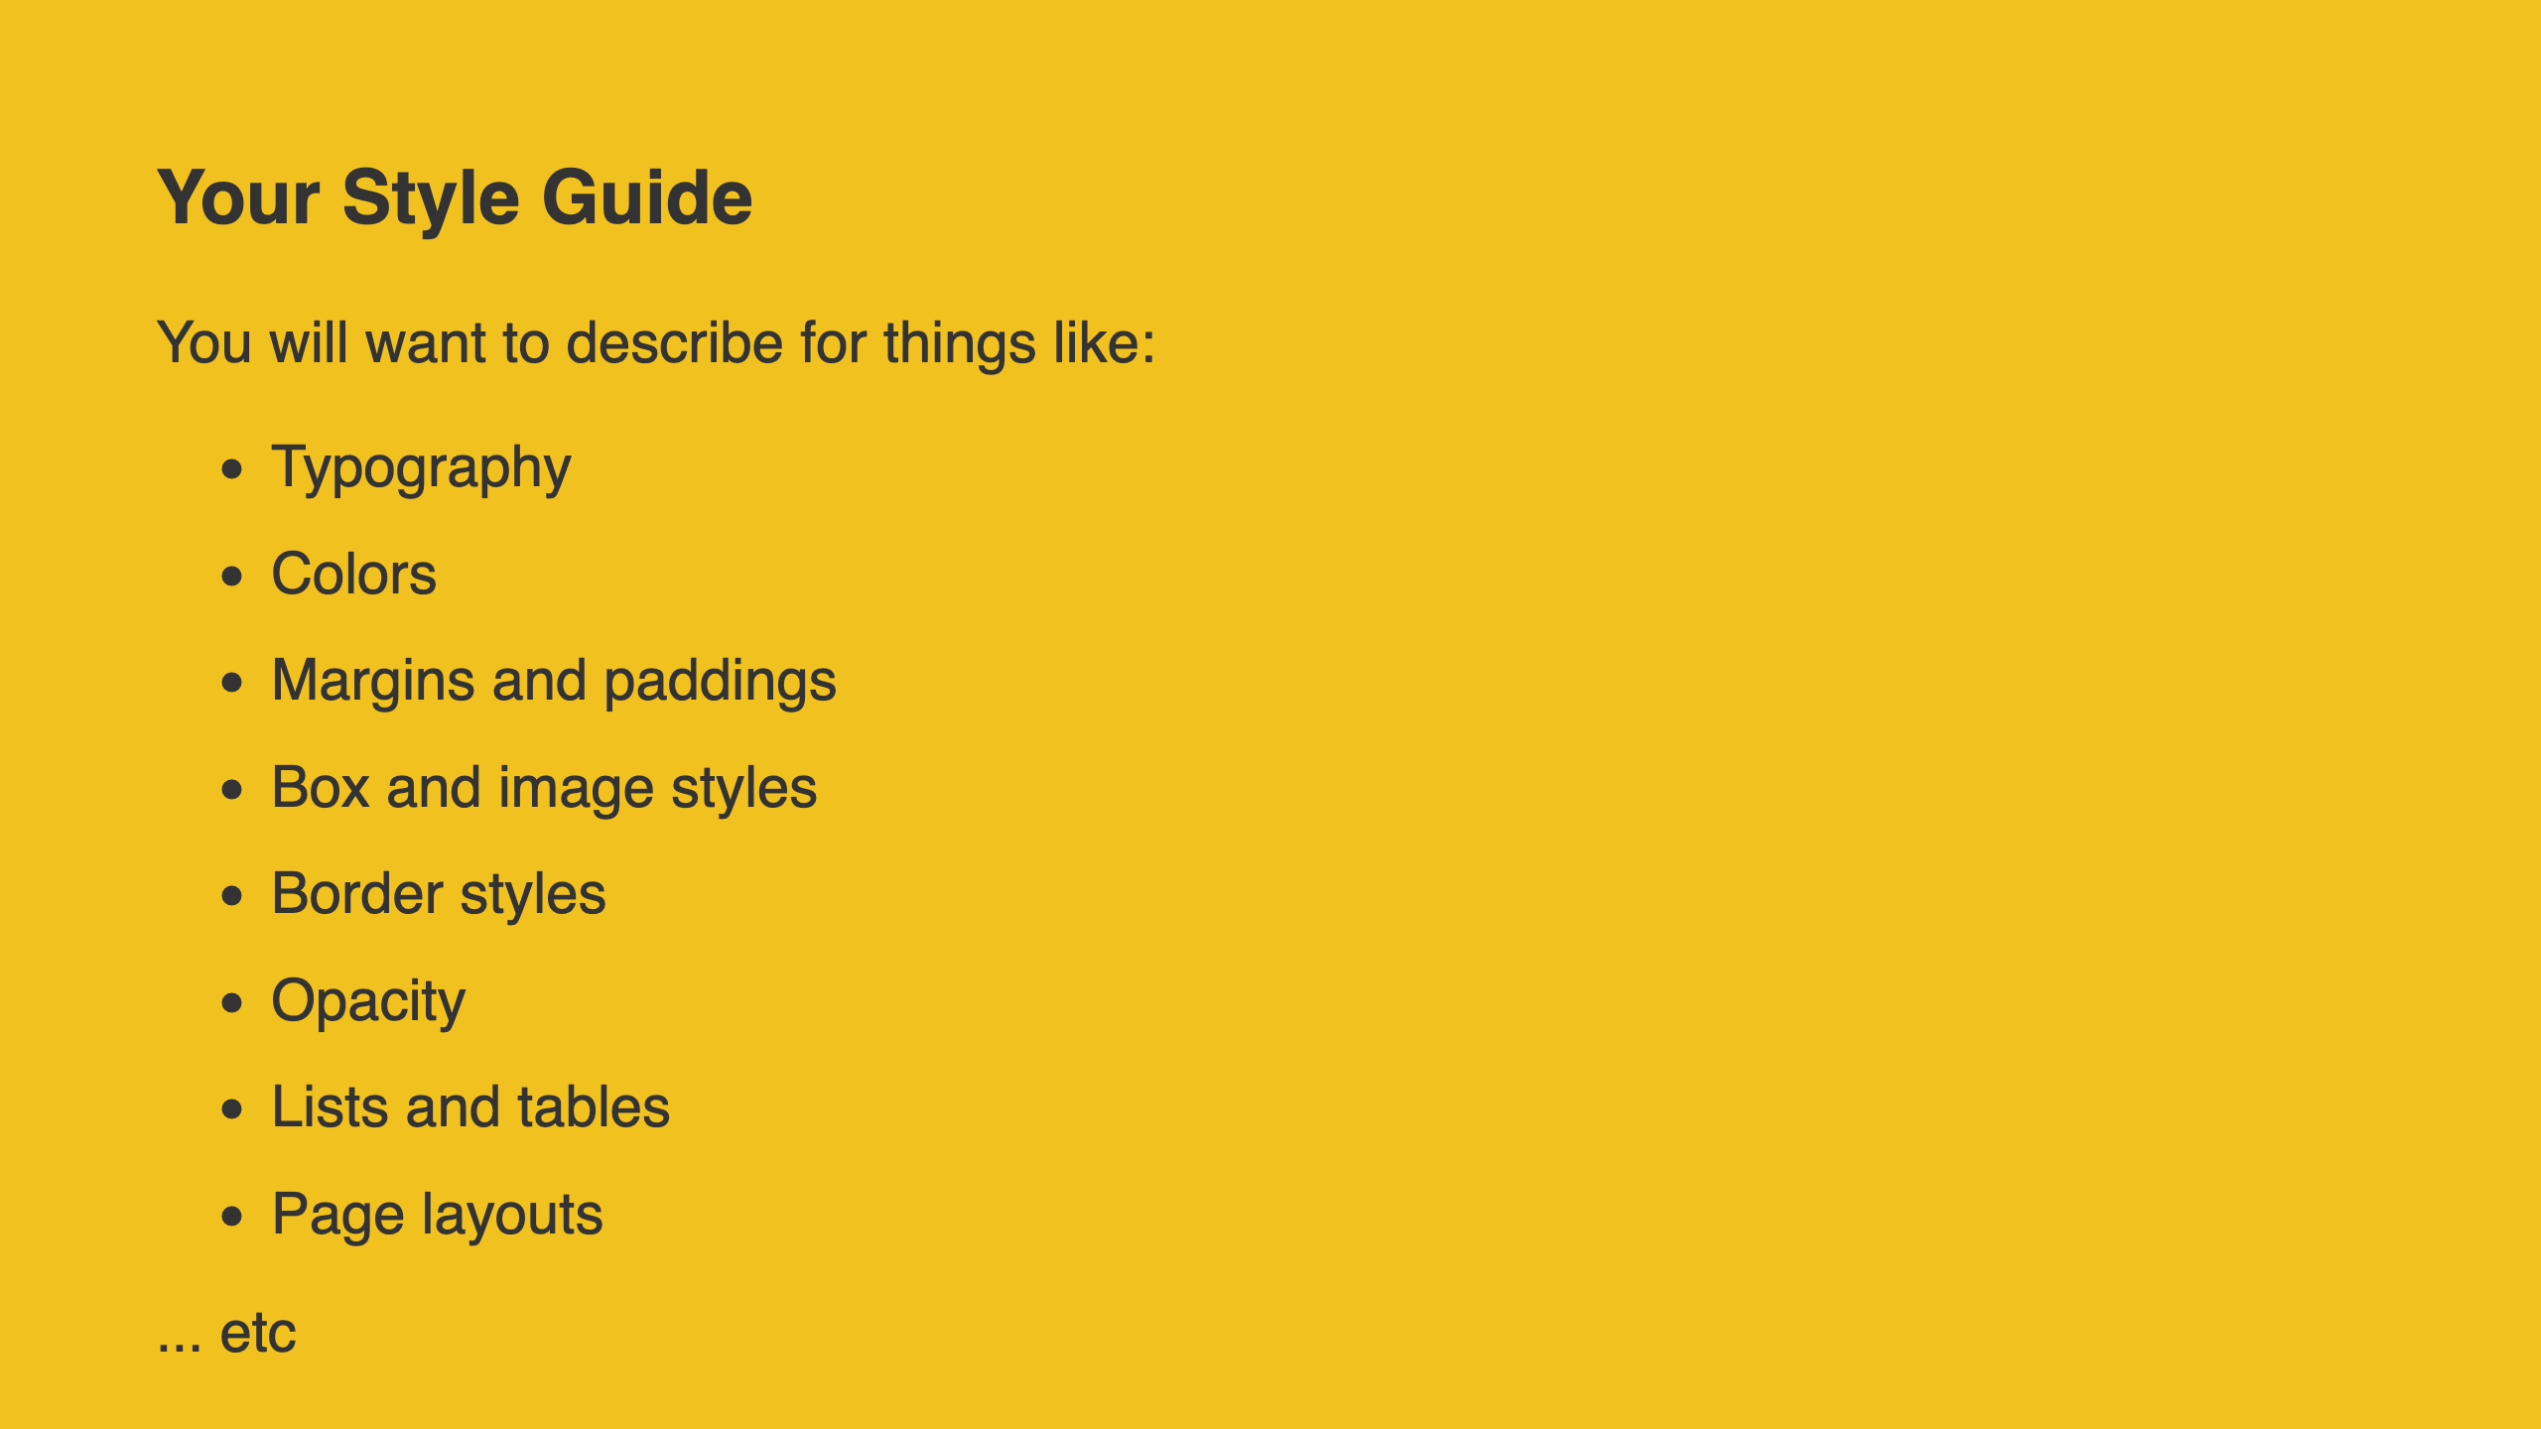
Notes:
shadows, corner radiuses, widths and heights

Slide 13
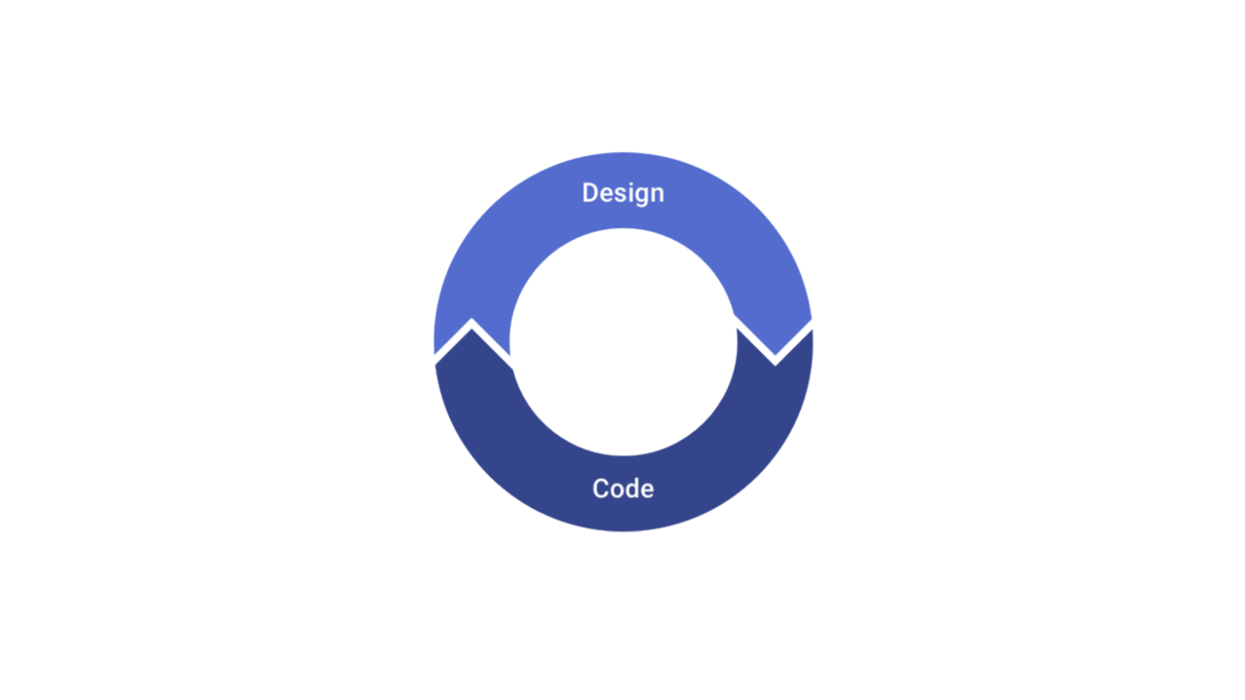
Notes:
Work in cycles
Instead of designing everything up front, work in short cycles. Start by
designing a simple version of the next feature you want to build.
Once you’re happy with the basic design, make it real.
You’ll probably run into some unexpected complexity along the way, but
that’s the point — it’s a lot easier to fix design problems in an interface you can actually use than it is to imagine every edge case in advance. Iterate on the working design until there are no more problems left to solve,

Slide 14
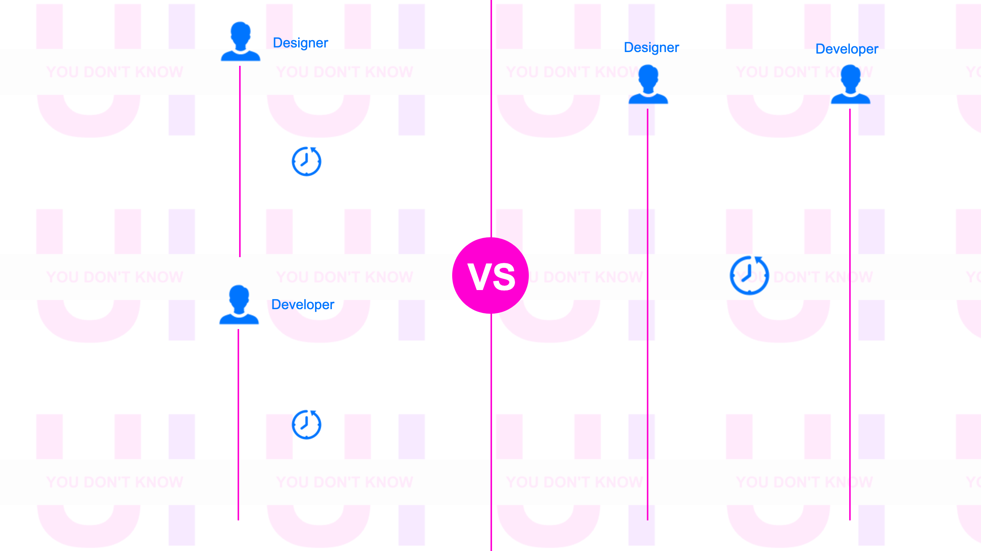

Slide 15
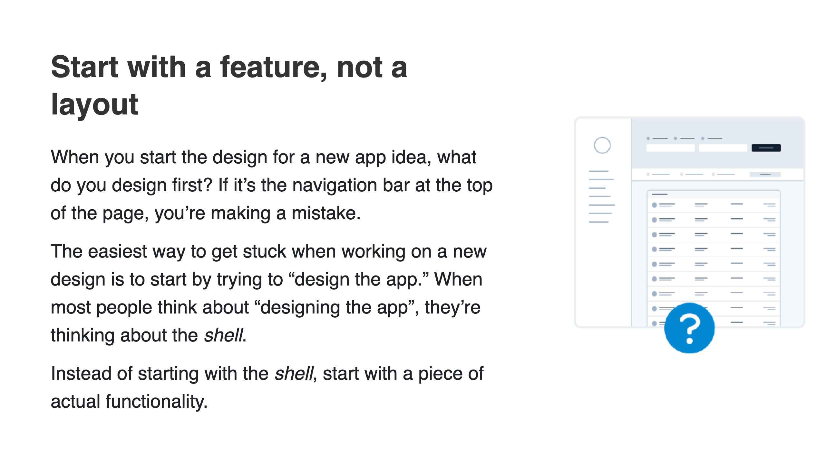

Slide 16
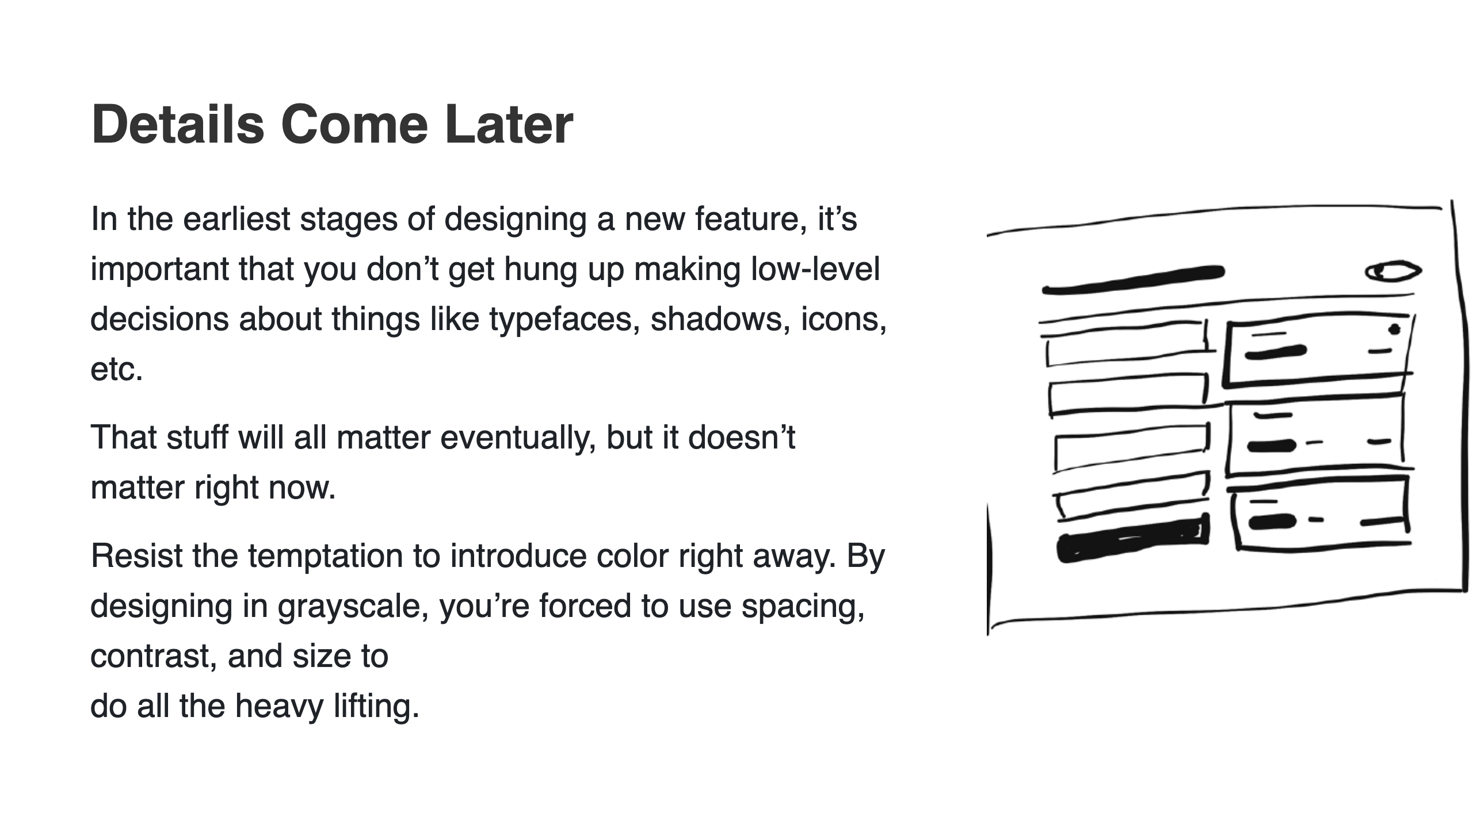

Slide 17
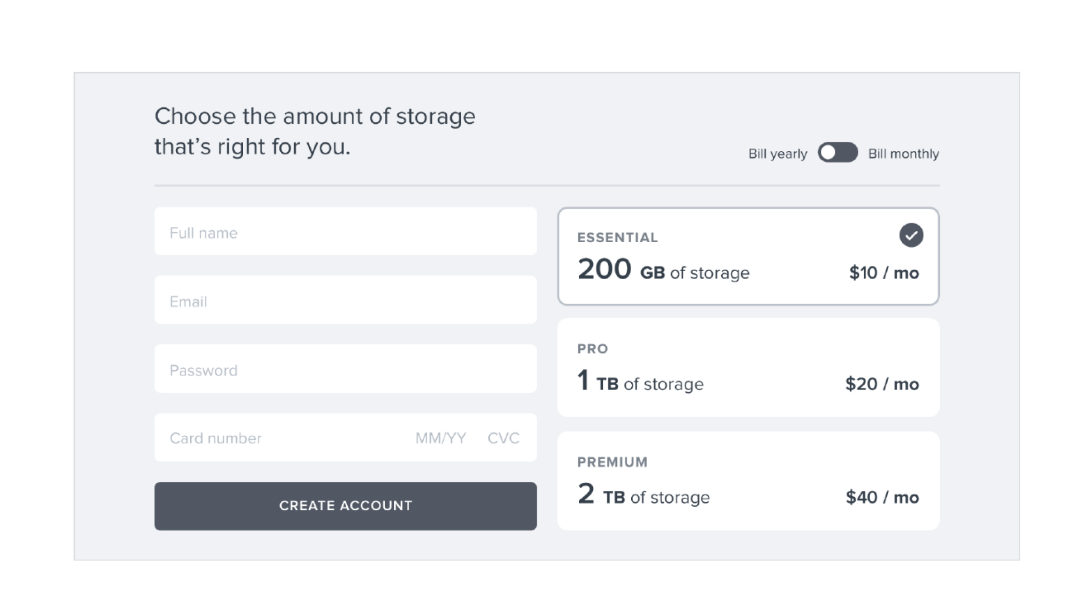

Slide 18
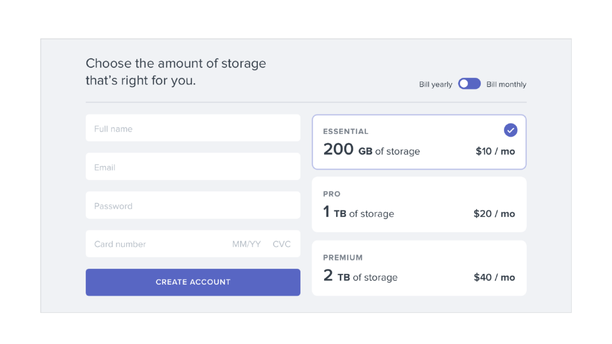

Slide 19
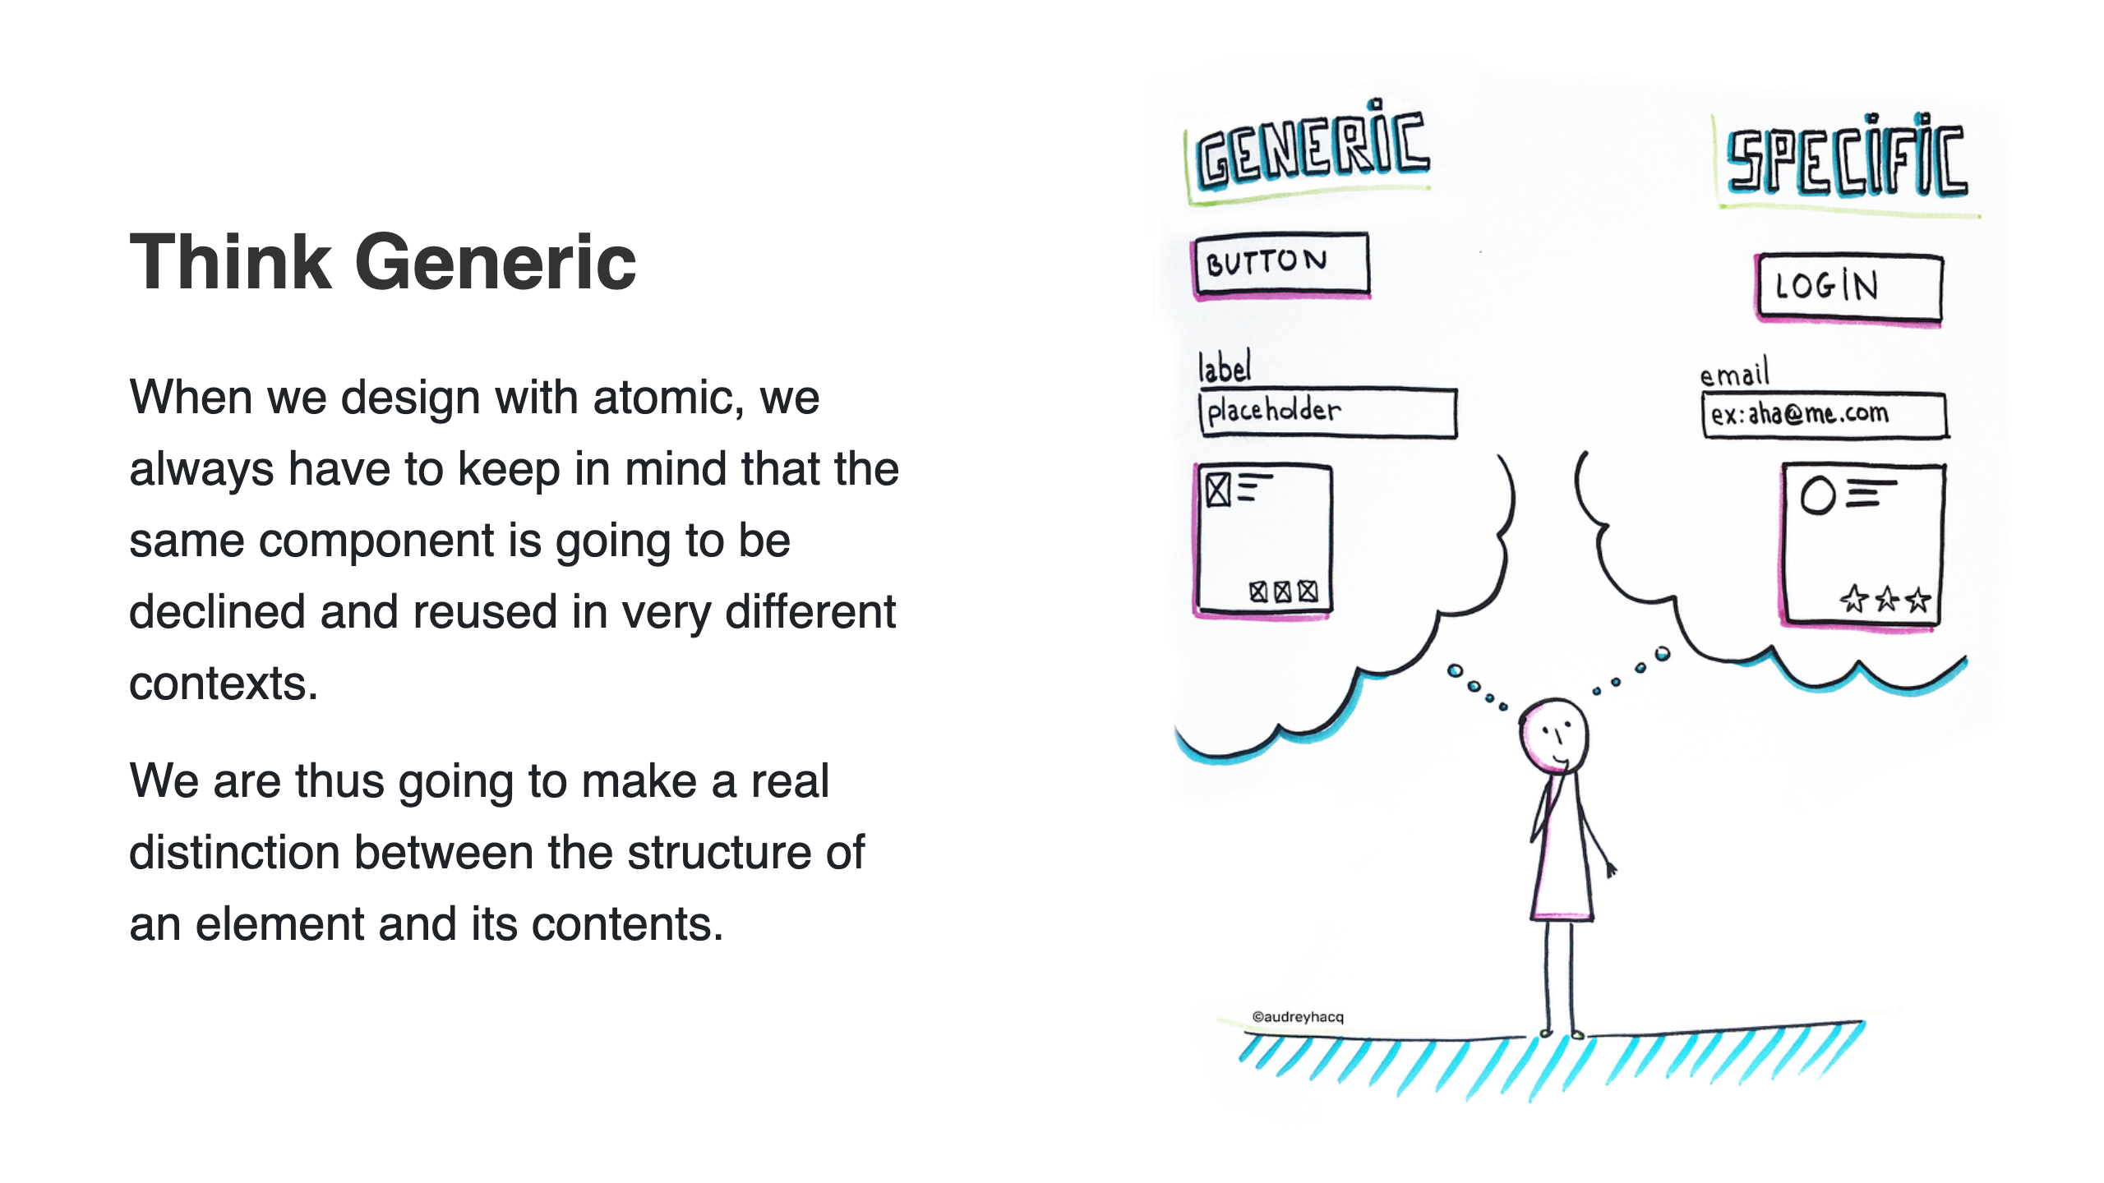
Notes:
Source: https://idevie.com/design/ux/atomic-design-how-to-design-systems-of-components

Slide 20
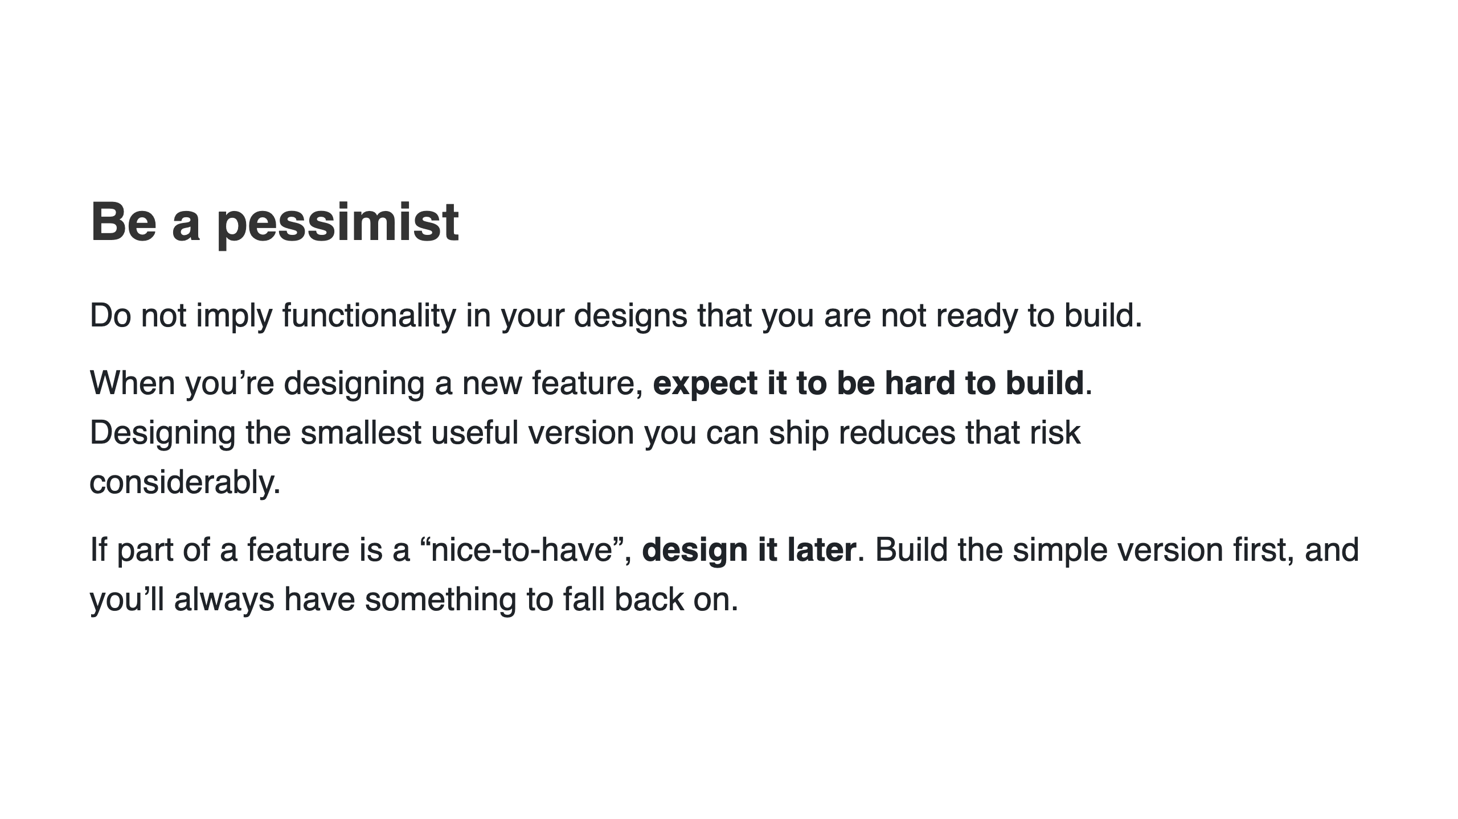

Slide 21
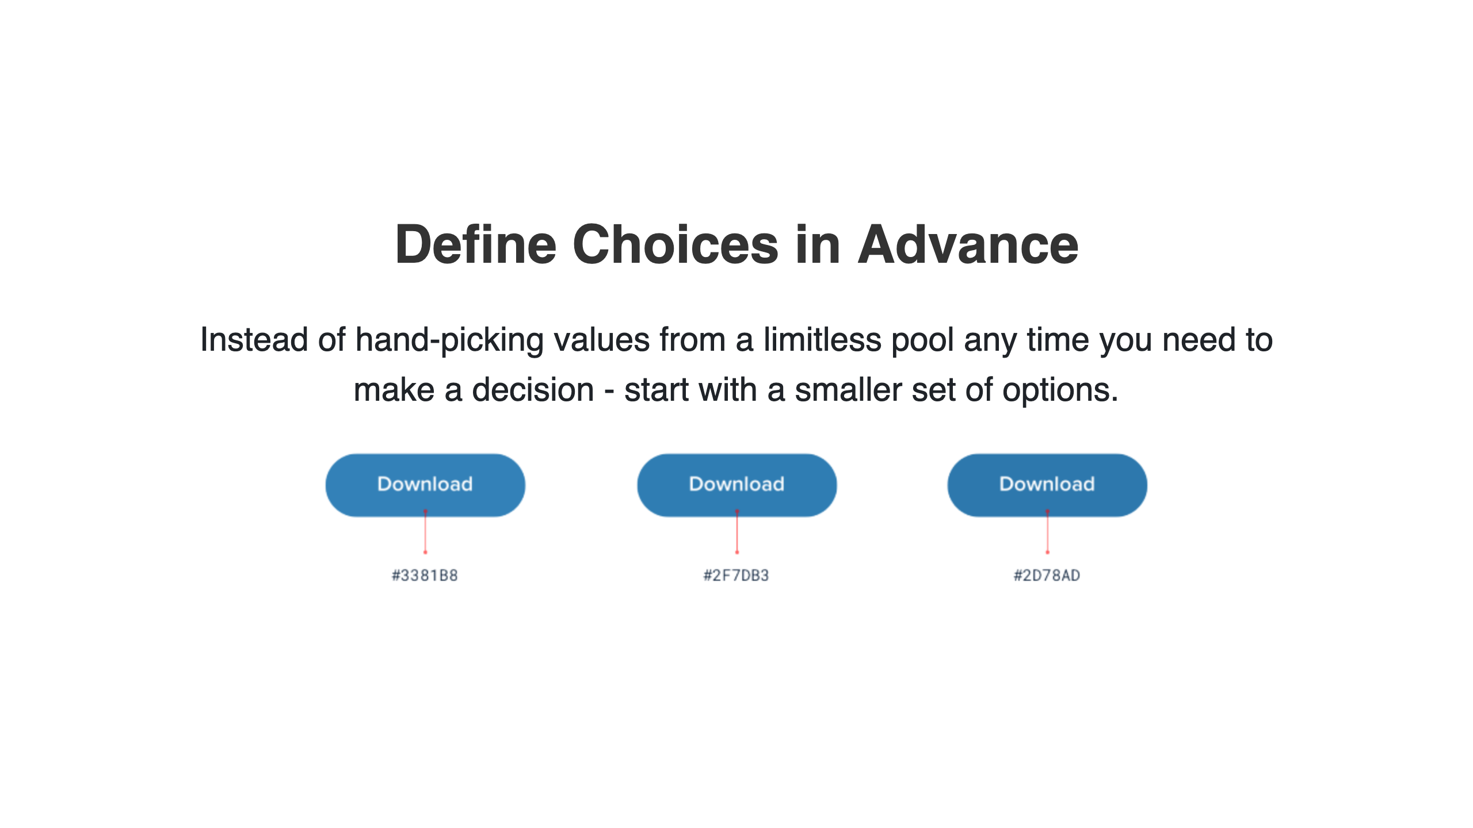
Notes:
>
Don’t reach for the
color picker every time you need to pick a new shade of
blue — choose from a set of 8-10 shades picked out ahead of time.
Similarly, don’t tweak a font size one pixel at a time until it looks perfect.
Define a restrictive type scale in advance and use that to make any future
font size decisions.
Try and stick to two or three colors:
* A dark color for primary content (like the headline of an article)
* A grey for secondary content (like the date an article was published)
* A lighter grey for tertiary content (maybe the copyright notice in a
footer)
Similarly, two font weights are usually enough for UI work:
* A normal font weight (400 or 500 depending on the font) for most text
* A heavier font weight (600 or 700) for text you want to emphasize

Slide 22
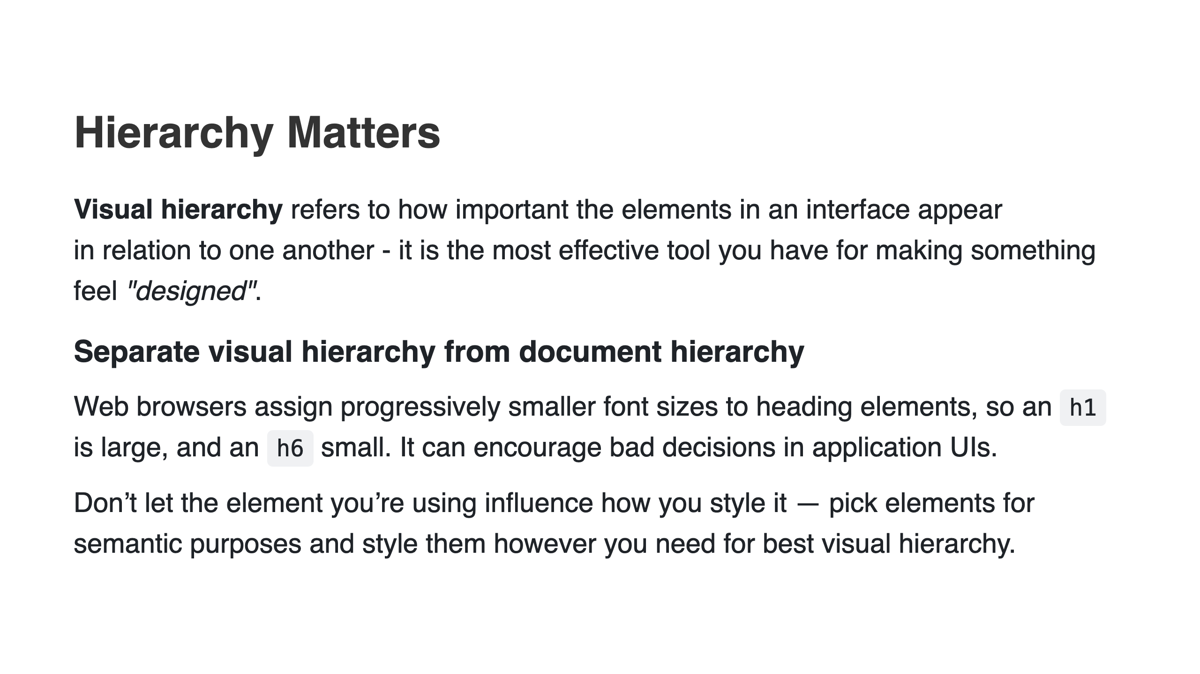
Notes:
When everything in an interface is competing for attention, it feels noisy and
chaotic, like one big wall of content where it’s not clear what actually
matters:

Slide 23
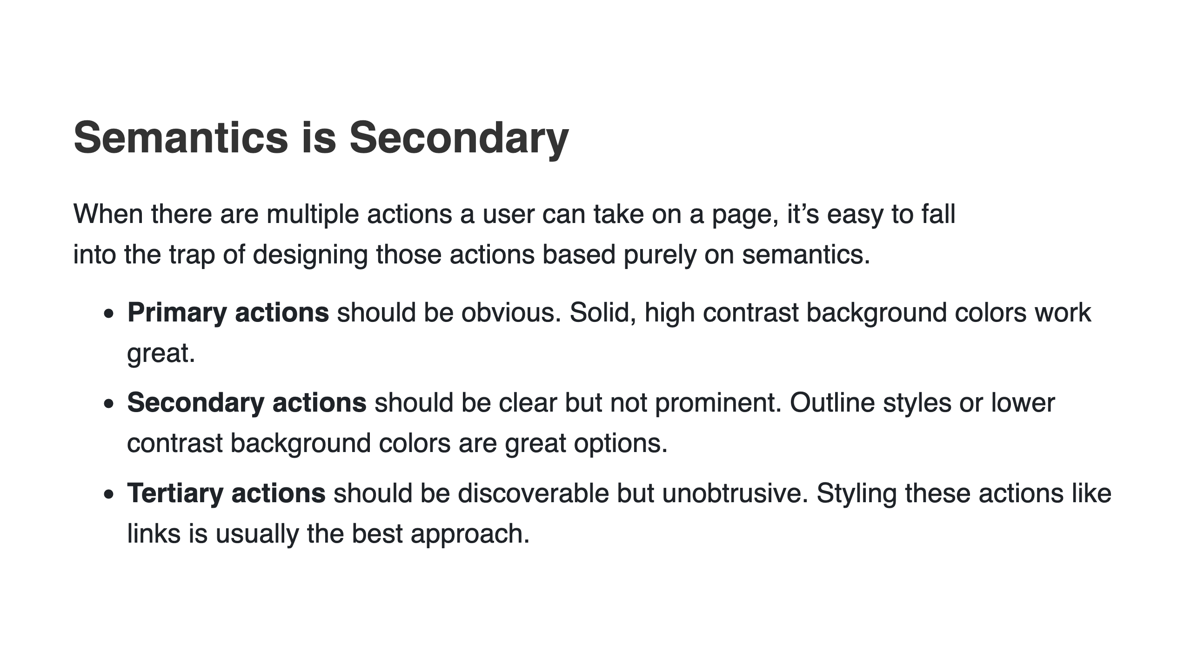
Notes:
# Destructive actions
Being destructive or high severity doesn’t automatically mean a button
should be big, red, and bold.
If a destructive action isn’t the primary action on the page, it might be better
to give it a secondary or tertiary button treatment.
Combine this with a confirmation step where the destructive action actually
is the primary action, and apply the big, red, bold styling there.

Slide 24
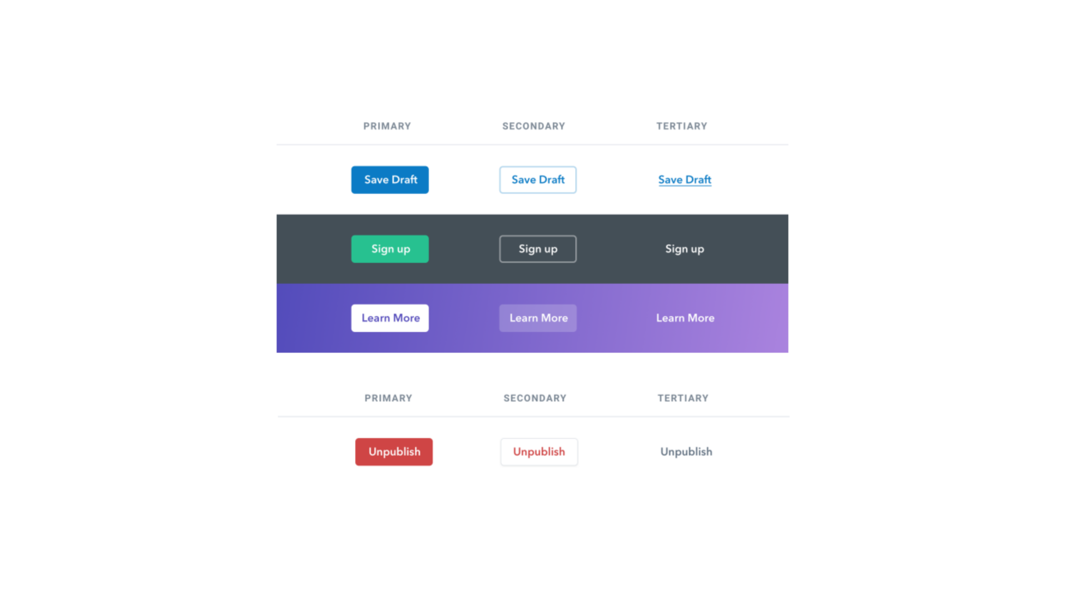

Slide 25
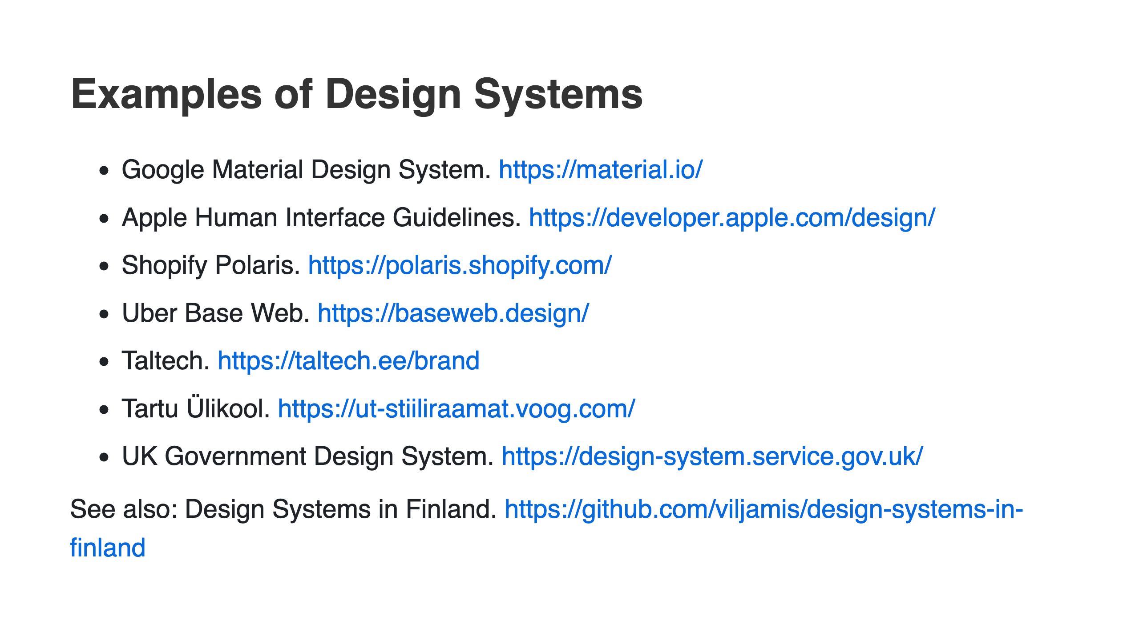
Notes:
**TED Logo guidelines:**
https://www.ted.com/participate/organize-a-local-tedx-event/tedx-organizer-guide/branding-promotions/logo-and-design/your-tedx-logo
**Struktuurifondide logo:**
https://www.eas.ee/images/doc/sihtasutusest/logo_rakendused/Teavituse_meelespea_SF.pdf
file:///D:/Downloads/kkk_teavitusreeglid_08_2015.pdf
https://riigikantselei.ee/valitsuslogo

Slide 26
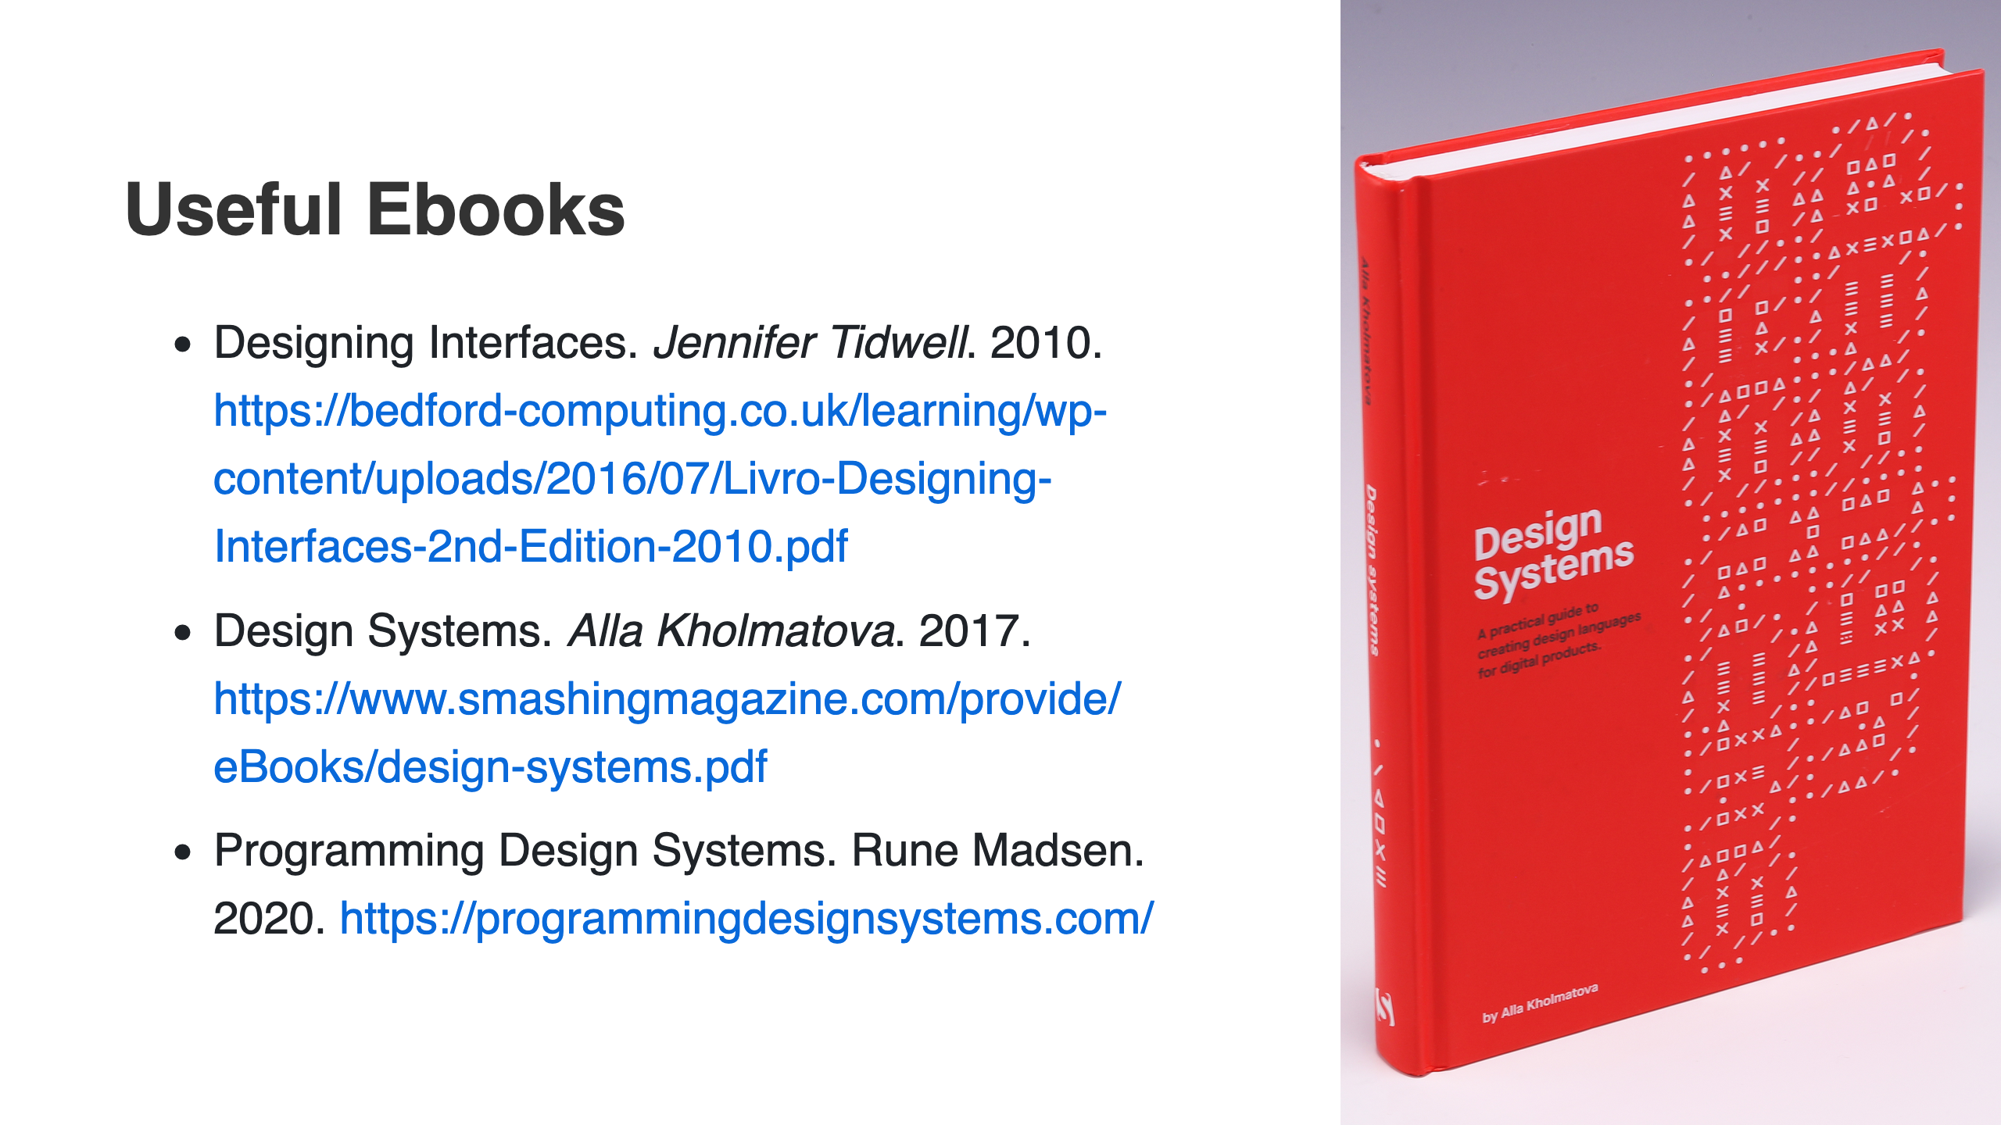

Slide 27
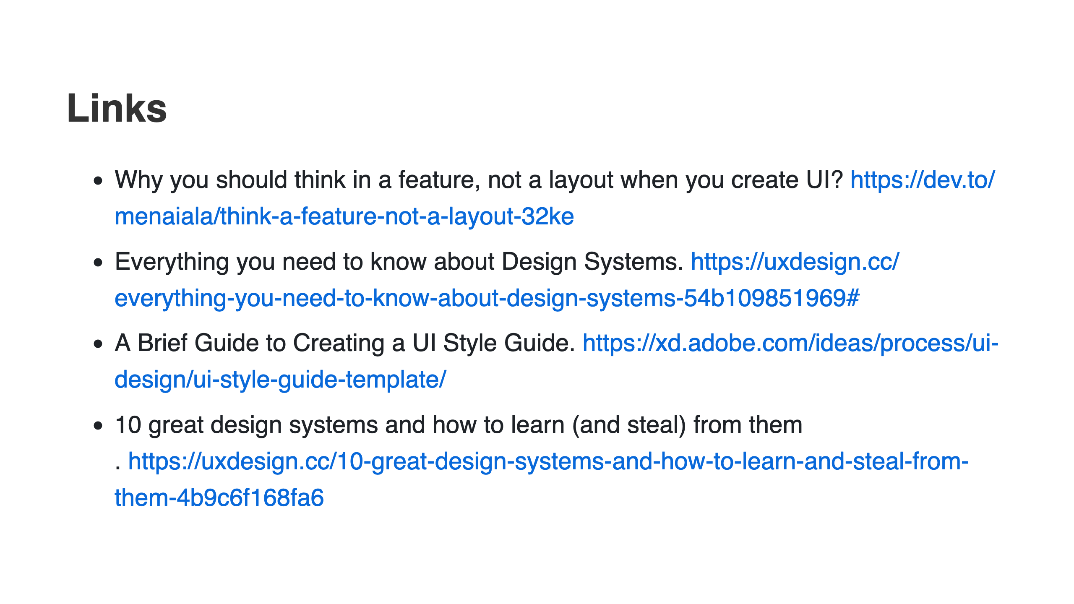
Notes:
A Brief History of Design Systems. https://medium.com/@jgulsen_97727/a-very-brief-history-of-design-systems-part-1-d661a7c70002

Slide 28


