Slide 2
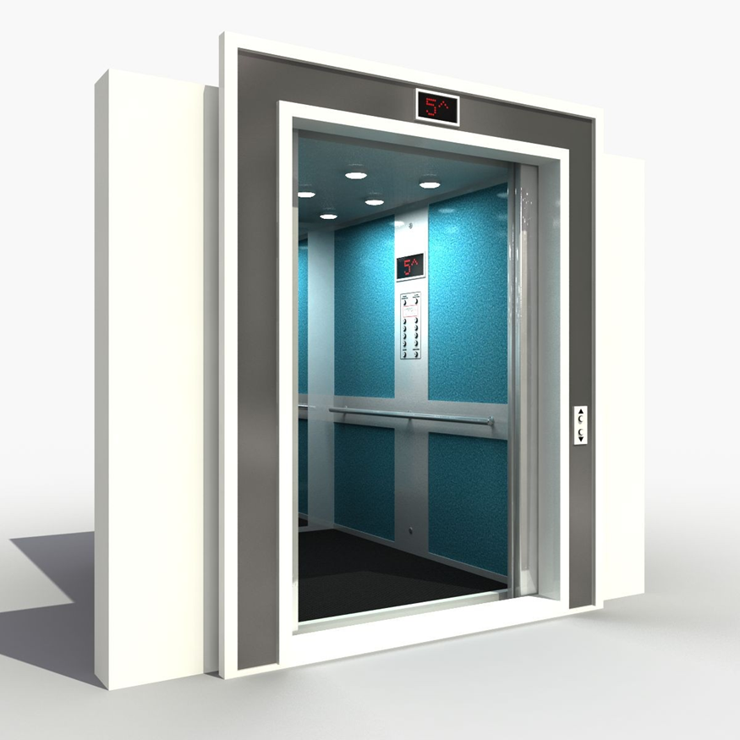
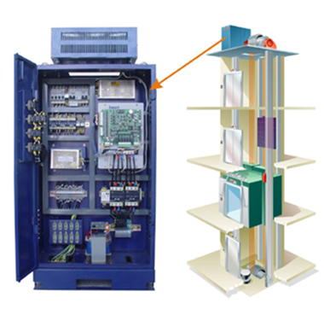
Floor Sensor
Car
Display
Floor Display
Controller
Floor Panel
UP/DOWN
Car
Panel

Slide 3
Steps
1. Requirements collection and specification
1.1. Write the requirements in flat English
1.2. Group the requirements into categories like: functional, safety, comfort
2. Architecture design:
2.1. Extract the components from requirements
2.2. Distinquish active and passive components.
2.2.1 The active components have their own behavior
2.2.2 Passive ones are represented as data structures (variables, arrays)
2.3. Define input and output data of components
2.4. Define links between inputs and outputs of comonents
3. Specify internal behavior of components (states, transitions, transition conditions and updates)
4. Specify interface bahavior of components (synchronization and data links between components).
5. Add timing specification to the behavior

